Slide 1

Time Series Prediction for Weather Forecasting
B.Karthik kumar(192225058)
Guided by Dr.Rama

Slide 2
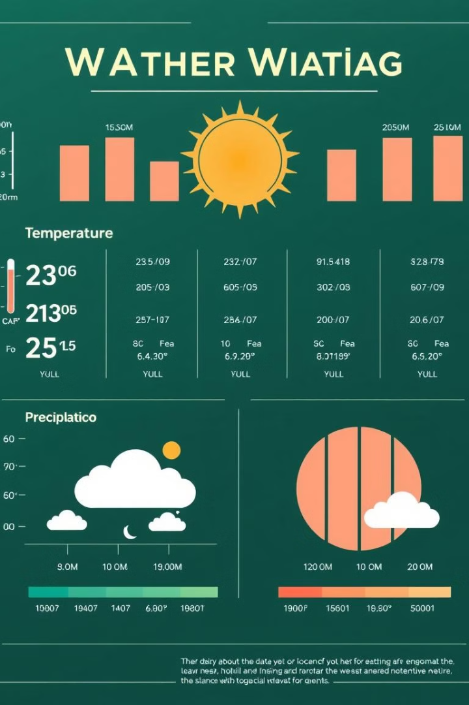
Understanding Weather Data and Time Series
1
Time-dependent Data
2
Cyclical Patterns
Weather data exhibits a strong temporal dependence, with measurements changing over time.
Weather patterns often follow predictable cycles, such as daily, weekly, and seasonal variations.
3
Complex Interactions
4
Spatial Variability
Weather variables are interconnected, with changes in one affecting others.
Weather conditions can vary significantly across different locations.

Slide 3
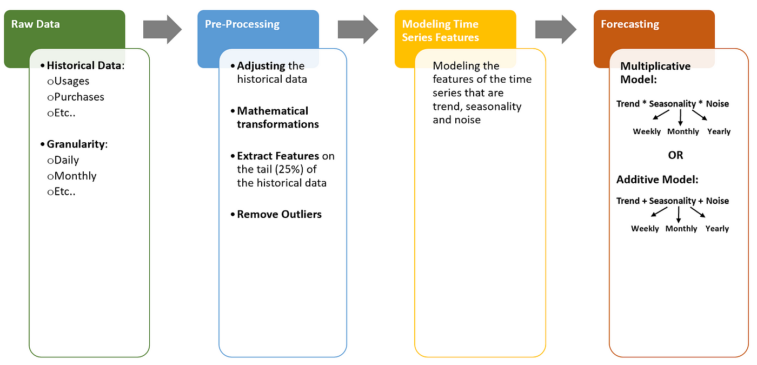
Techniques for Time Series Prediction
Moving Averages
Exponential Smoothing
ARIMA Models
Smoothing out short-term fluctuations to identify trends.
Giving more weight to recent data for better forecasting.
Modeling relationships between past and future values for accurate predictions.

Slide 4

Preprocessing and Feature Engineering
Data Cleaning
Feature Selection
Handling missing values, outliers, and inconsistencies to improve model accuracy.
Choosing the most relevant features for model training, reducing complexity and improving performance.
1
2
3
Feature Extraction
Creating new features from existing data, such as lagged values or derived variables.

Slide 5

Modeling Approaches for Weather Prediction
Linear Regression
Support Vector Machines (SVMs)
Predicting weather variables based on linear relationships with historical data.
Finding optimal boundaries to separate different weather conditions for classification tasks.
Neural Networks
Learning complex patterns and nonlinear relationships from weather data for advanced predictions.

Slide 6
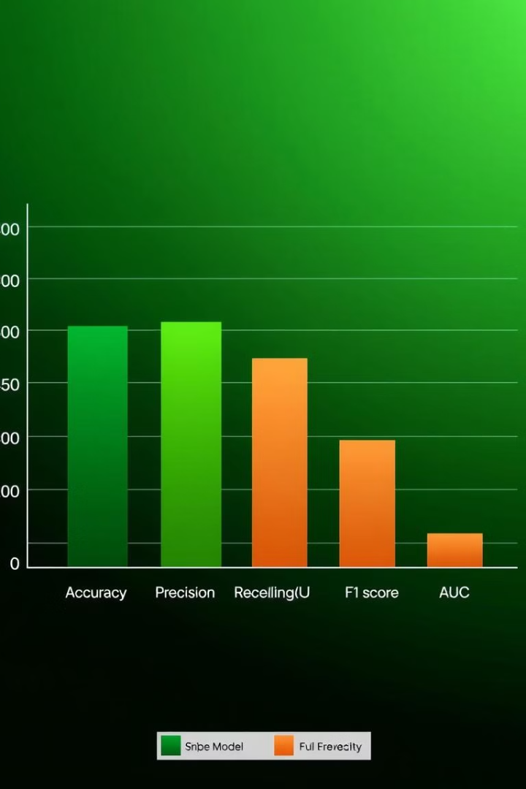
Evaluating Model Performance
Metric
Description
Mean Absolute Error (MAE)
Average absolute difference between predicted and actual values.
Root Mean Squared Error (RMSE)
Measures the overall accuracy of the model, considering both magnitude and direction of errors.
R-squared
Indicates the proportion of variance in the target variable explained by the model.

Slide 7
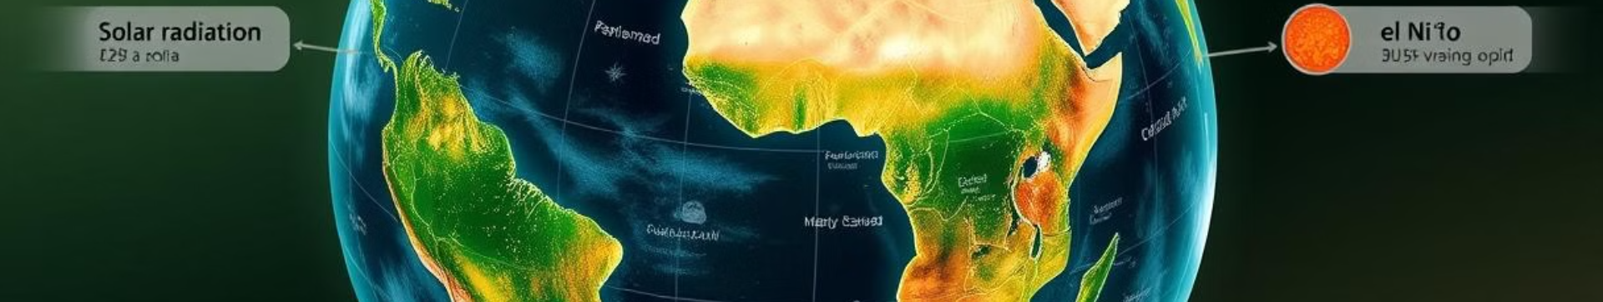



Incorporating External Factors
Solar Activity
El Niño-Southern Oscillation (ENSO)
Volcanic Eruptions
The Sun's radiation influences Earth's climate and weather patterns.
Volcanic ash and gases can influence atmospheric conditions, affecting weather patterns.
A climate pattern that can affect global weather, including rainfall and temperature.

Slide 8





Practical Applications and Future Directions
Agricultural Planning
Aviation Safety
Predicting rainfall and temperature for optimal crop growth.
Forecasting weather conditions for safe flight operations.
Energy Management
Disaster Preparedness
Optimizing energy production and consumption based on weather forecasts.
Forecasting extreme weather events for timely evacuation and mitigation efforts.

Slide 9

Conclusion
Time series prediction plays a vital role in weather forecasting, enabling us to anticipate future conditions and make informed decisions. Continued advancements in modeling techniques, data availability, and computational power will lead to even more accurate and reliable weather predictions in the future.

